Slide 1
CS23403 – FULL STACK TECHNOLOGIES
UNIT 2 – NODE.JS AND FRAMEWORKS
B.E. COMPUTER SCIENCE AND ENGINEERING
2023 REGULATION

Slide 2
Working with Node Packages
A Node Packaged Module is a packaged library that can easily be shared, reused and installed in different projects – NPM & NPM’s
Includes Package. Json file that define the packages – contains informational meta data and control metadata
A Node Package Manager is a command-line utility that allows developers to find, install, remove, update and publish Node Packaged Modules.
Acts as link between the Node Package Registry and the local development environment

Slide 3
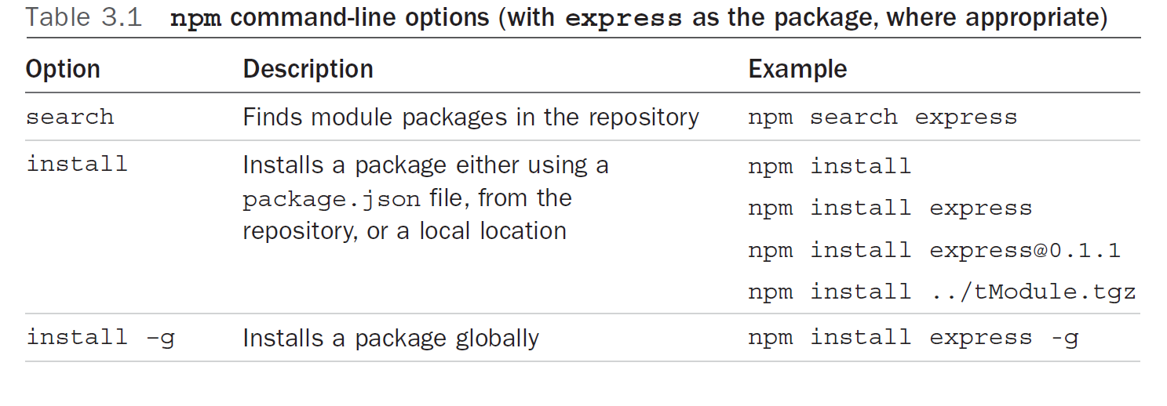
NPM – Command Lines

Slide 4
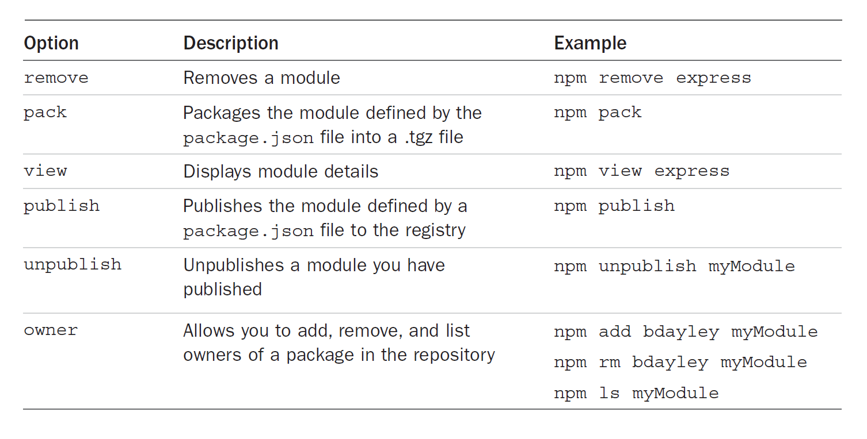
NPM – Command Lines

Slide 5
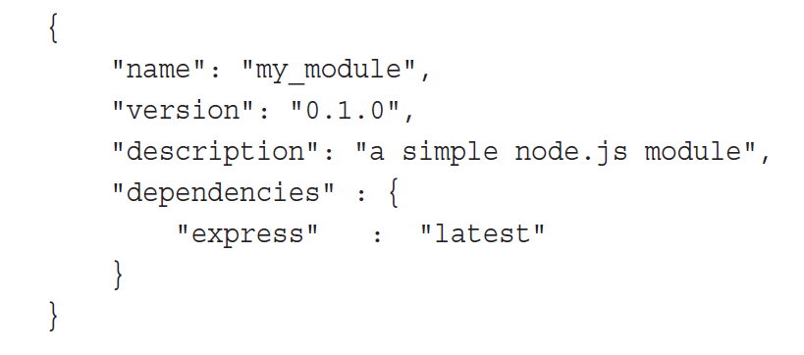
Using Package.JSON
Managing a Node.js project’s metadata and dependencies so that NPM can automatically install and maintain required modules.
This is done using a single configuration file
Package . JSON contains - Project name - Project version - Which libraries are needed (dependencies) - How to run the project (scripts)
Package.json file which needs to be the root of project code

Slide 6
Creating a Node.JS Application
Create the functionality in JavaScript
Define the package using a package.json file
Publish it to the registry or package it

Slide 7
Steps to create and use a Node.JS Packaged Module
Create a project folder Example: simplemath/ (This folder is the root of the module)
2) Create a JavaScript file with functionality(Node.JS) Example: simplemath.js
function add(a, b) {
return a + b;
}
exports.add = add; // function to export

Slide 8
Steps to create and use a Node.JS Packaged Module
3) Create a package.json file This defines the module.
{
"name": "simplemath",
"version": "1.0.0",
"main": "simplemath"
}

Slide 9
Steps to create and use a Node.JS Packaged Module
4) Open terminal inside the module folder Run the command:
npm pack
5) This creates a file like simplemath-1.0.0.tgz. //TGZ is the packaged form of a Node.js module, similar to a ZIP file (packs the .js file and .json file)

Slide 10
Steps to create and use a Node.JS Packaged Module
6) Install & Use the module in another Node.js file npm install ./simplemath-1.0.0.tgz
Example: app.js
var math = require("simplemath");
console.log(math.add(5, 3));
7) Run the application node app.js
8) Output : 8
A Node.js packaged module is created by writing JavaScript code, exporting functions, defining the module using package.json, packaging it with npm, and importing it using require() – (Common JS) or import() - (ECMA Script Modules - ESM)

Slide 11
Package . JSON & Node_ Modules
Package.json tells npm what the project needs, while node_modules contains the actual installed packages.
package.json | node_modules
It is a JSON configuration file | It is a folder
Describes the Node.js project | Stores actual Node.js packages
Lists project name, version, and dependencies | Contains installed libraries and their code
Created manually or using npm init | Created automatically by npm
Readable and editable by developers | Not meant to be edited manually
Tells npm what to install | Contains what is installed
Acts as an instruction file | Acts as a storage location

Slide 12
Working with Node Packages
Package → Ready-made solution
npm → Tool that provides packages
package.json → Requirement list
node_modules → Storage place
Eg: The package is the ready-made furniture, npm is the furniture shop, package.json is the specification of furniture along with the things to buy, and node_modules is the store room where all the furniture is kept.

Slide 13
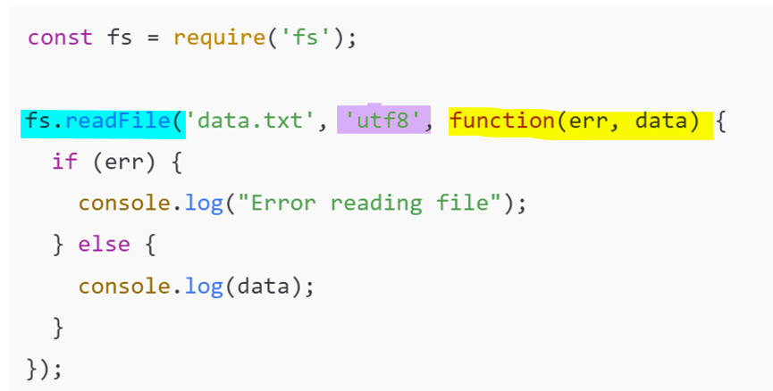




Filesystems – Buffer - Streams
The File System (fs) module in Node.js allows applications to read, write, update, delete, and manage files on the server.
Node.js can directly interact with files because it runs outside the browser.
fs.readFile() reads the file asynchronously (waits for a callback function to diplay the result)
utf8 converts file content to readable text (binary data to buffer)
Callback handles result ( runs later, after the file reading is complete)

Slide 14
Filesystems – Buffer - Streams
A Buffer is a temporary memory area used to store binary data.
const fs = require("fs");
fs.readFile("data.txt", (err, data) => {
console.log(data); // Buffer output
console.log(data.toString()); // Readable text
});

Slide 15
Filesystems – Buffer - Streams
A Stream is a way to read or write data piece by piece/ chunk by chunk, instead of loading everything at once
Data is processed as it arrives – memory efficiency – enables non – blocking I/O (node.js doesn’t wait for I/O to finish – tasks runs in the background)
const fs = require('fs');
const readStream = fs.createReadStream('largefile.txt');
readStream.on('data', (chunk) => { //process data as it comes //not blocking IO
console.log("Received chunk:", chunk.toString());
});

Slide 16
Using Events
Node.js uses an event‑driven architecture — it waits for things (events) to happen and then responds to them.
This is one of the reasons Node.js is fast and scalable — it doesn’t block while waiting for tasks to finish.
Node.js has a built‑in EventEmitter class (we can emit an event and listen to it)
Events let Node.js handle tasks asynchronously, making programs faster, non-blocking and capable of managing many operations at once.
Why Events? Events are used to handle actions that occur asynchronously or unexpectedly, whereas if and for loops are used for predefined, synchronous control flow.

Slide 17
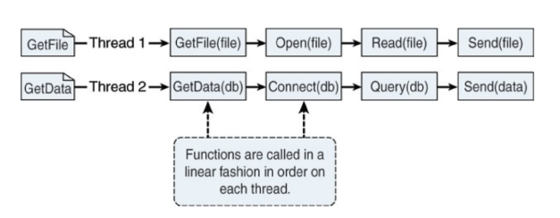
Node.JS – Event Callbacks and Threaded Model
A thread is a small execution unit inside a program.
Node.Js runs on single threaded event driven model – doesn't involve the concept of multi threaded model.
Below figure is how two requests are processed on individual threads using the threaded model

Slide 18
Node.JS – Event Callbacks and Threaded Model
Instead of focusing on individual threads, work is added to an event queue
Then the event queue is picked up by a single thread running a event loop
Event loop executes the top item of the event queue (functions and callbacks are included in the event queue)
Event loop terminates after all the Node.js queue events are executed
Node.js does not process requests one after another; it switches between them using events and callbacks.

Slide 19
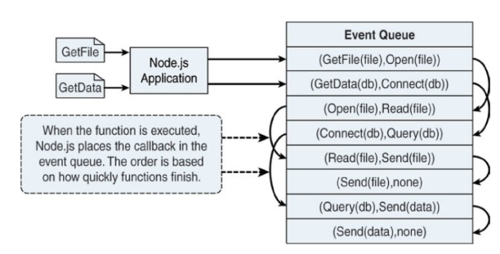
Event Loop
Request 1 - I/O task - waiting (background)
|
Request 2 - processed immediately - response sent
|
Request 1 callback executes - response sent

Slide 20
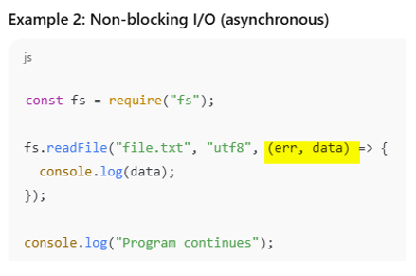
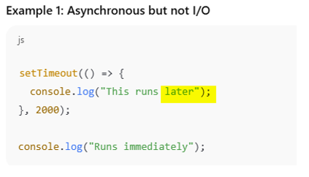
All non-blocking I/O in Node.js is asynchronous, but not all asynchronous operations are non-blocking I/O
Examples of Non Blocking IO can be Reading a file, Querying a DB, Socket request, Accessing a remote service
Callbacks are placed in the thread pool instead of main event loop thread

Slide 21
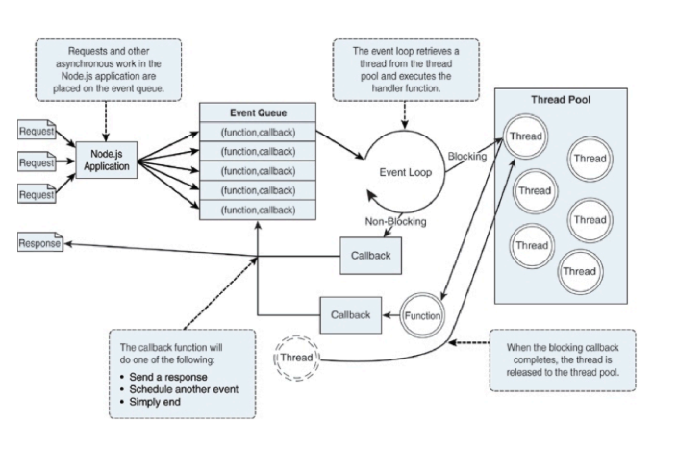
Node.Js event model – with event queue, event loop and pool thead

Slide 22
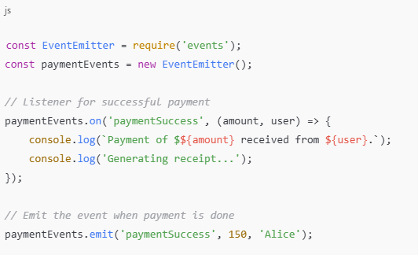
Listeners
Event: paymentSuccess - triggered when payment is successful.
Listener: Handles tasks after payment succeeds (e.g., sending receipt, updating database).
'paymentSuccess' is a custom event.
on() defines the listener.
emit() triggers the event.

Slide 23

Timers
Node.js provides timer functions to schedule code to run later or repeatedly.
Timer function can delay the execution of code for a period of time
Common timers:
setTimeout() → Run once after delay
setInterval() → Run repeatedly every interval
setImmediate() → Run after the current event loop
process.nextTick() → Run before next event loop (one event cycle) – high priority request can be executed

Slide 24
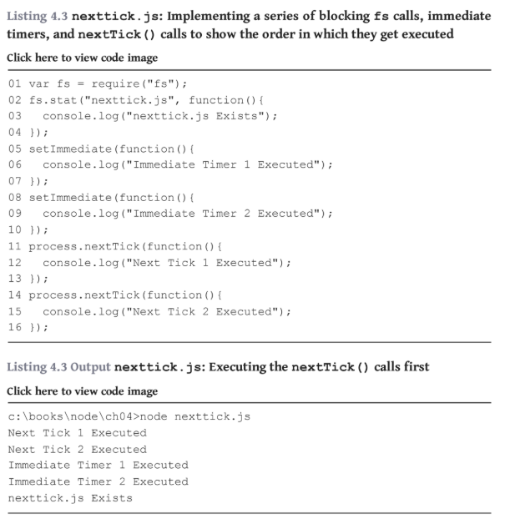

Slide 25
Event Listeners, Emitters And Removing Listeners
Event Emitter is a Node.js class used to create and handle custom events
const EventEmitter = require('events');
const emitter = new EventEmitter();
An event listener is a function that executes when a specific event is emitted.
emitter.on('paymentSuccess', () => {
console.log('Payment successful. Sending receipt.');
});

Slide 26
Event Listeners, Emitters And Removing Listeners
Emitting an event means notifying all listeners that the event has occurred.
emitter.emit('paymentSuccess’);
Removing listeners prevents a function from responding to future events.
RemoveListener()
Once() – auto removal after single execution
emitter.once('login', () => {
console.log('First login detected');
});

